Slide 1
Data Analytics - Lesson 17 Random Forest using R
Jeffrey Strickland, Ph.D., CMSP, ASEP
CEO Humalytica Analytics

Slide 2
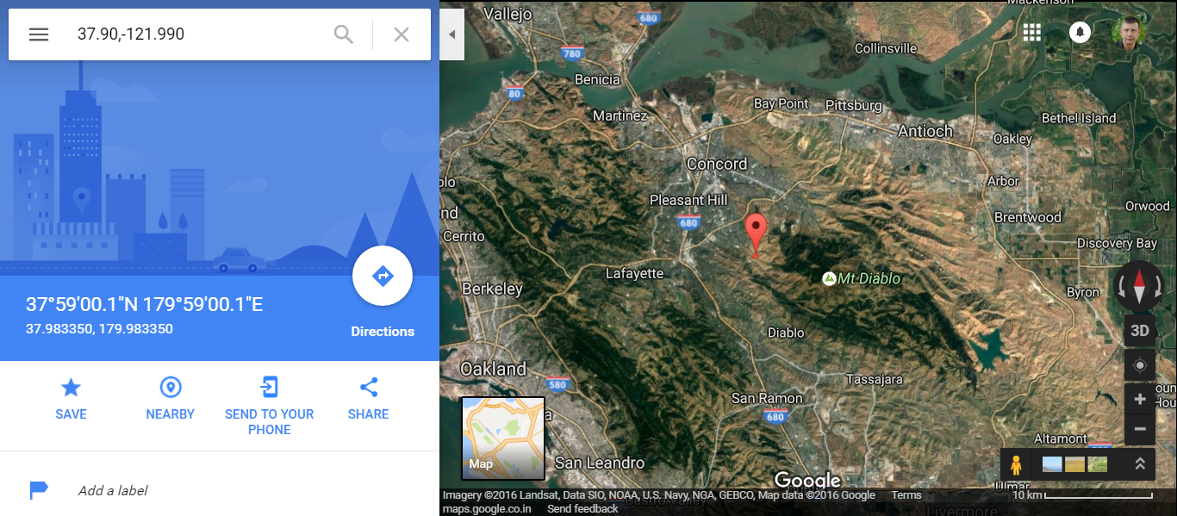
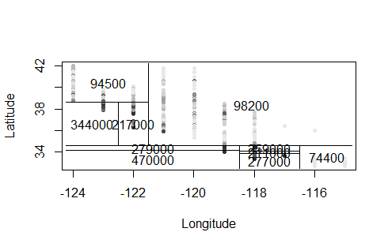
cadata – Home Values in California

Slide 3
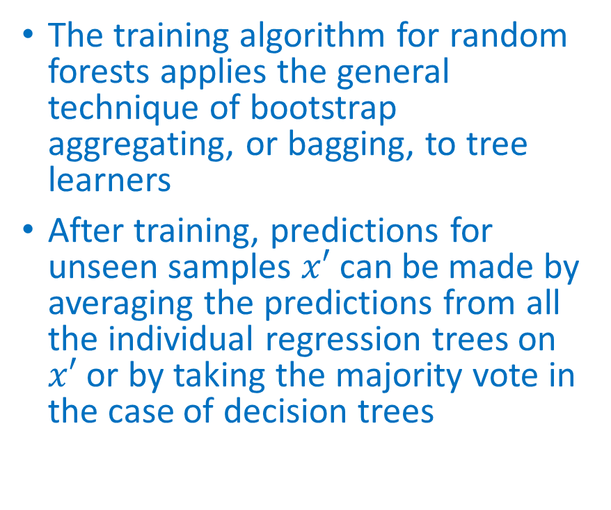
Random Forest
The training algorithm for random forests applies the general technique of bootstrap aggregating, or bagging, to tree learners
After training, predictions for unseen samples $x′$ can be made by averaging the predictions from all the individual regression trees on $x′$ or by taking the majority vote in the case of decision trees
Random forests are an ensemble learning method for classification (and regression) that operate by constructing a multitude of decision trees at training time and outputting the class that is the mode of the classes output by individual trees
The algorithm for inducing a random forest was developed by Leo Breiman (Breiman L. , Random Forests, 2001) and Adele Cutler (Liaw, 2012), and “Random Forests” is their trademark

Slide 4
What is Random Forest?
Random Forest is considered to be a panacea of all data science problems. On a funny note, when you can’t think of any algorithm (irrespective of situation), use random forest!
Random Forest is a versatile machine learning method capable of performing both regression and classification tasks. It also undertakes dimensional reduction methods, treats missing values, outlier values and other essential steps of data exploration, and does a fairly good job. It is a type of ensemble learning method, where a group of weak models combine to form a powerful model.

Slide 5
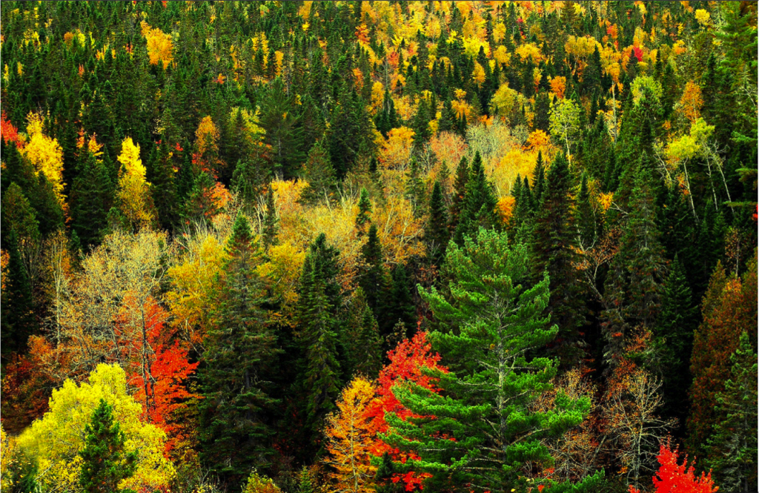
How does it work?
In Random Forest, we grow multiple trees as opposed to a single tree in CART model (see comparison between CART and Random Forest here, part1 and part2).
To classify a new object based on attributes, each tree gives a classification and we say the tree “votes” for that class.
The forest chooses the classification having the most votes (over all the trees in the forest) and in case of regression, it takes the average of outputs by different trees.

Slide 6
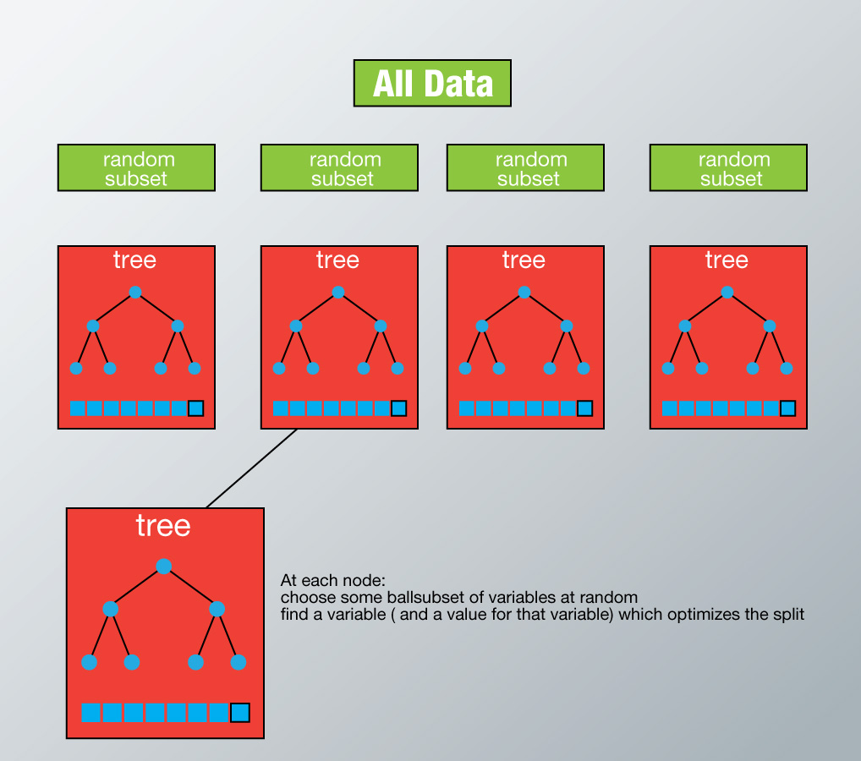
How does it work?
Each tree is planted & grown as follows:
Assume number of cases in the training set is N. Then, sample of these N cases is taken at random butwith replacement. This sample will be the training set for growing the tree.
If there are M input variables, a number m<M is specified such that at each node, m variables are selected at random out of the M. The best split on these m is used to split the node. The value of m is held constant while we grow the forest.
Each tree is grown to the largest extent possible and there is no pruning.
Predict new data by aggregating the predictions of the ntree trees (i.e., majority votes for classification, average for regression).

Slide 7
Advantages of Random Forest
This algorithm can solve both type of problems i.e. classification and regression and does a decent estimation at both fronts.
One of benefits of Random forest which excites me most is, the power of handle large data set with higher dimensionality. It can handle thousands of input variables and identify most significant variables so it is considered as one of the dimensionality reduction methods. Further, the model outputs Importance of variable, which can be a very handy feature (on some random data set).

Slide 8
Advantages of Random Forest
It has an effective method for estimating missing data and maintains accuracy when a large proportion of the data are missing.
It has methods for balancing errors in data sets where classes are imbalanced.
The capabilities of the above can be extended to unlabeled data, leading to unsupervised clustering, data views and outlier detection.
Random Forest involves sampling of the input data with replacement called as bootstrap sampling. Here one third of the data is not used for training and can be used to testing. These are called the out of bag samples. Error estimated on these out of bag samples is known as out of bag error. Study of error estimates by Out of bag, gives evidence to show that the out-of-bag estimate is as accurate as using a test set of the same size as the training set. Therefore, using the out-of-bag error estimate removes the need for a set aside test set.

Slide 9
Disadvantages of Random Forest
It surely does a good job at classification but not as good as for regression problem as it does not give precise continuous nature predictions. In case of regression, it doesn’t predict beyond the range in the training data, and that they may over-fit data sets that are particularly noisy.
Random Forest can feel like a black box approach for statistical modelers – you have very little control on what the model does. You can at best – try different parameters and random seeds!

Slide 10
What is Boosting ?
Definition: The term ‘Boosting’ refers to a family of algorithms which converts weak learner to strong learners.
Let’s understand this definition in detail by solving a problem of spam email identification:
How would you classify an email as SPAM or not? Like everyone else, our initial approach would be to identify ‘spam’ and ‘not spam’ emails using following criteria. If:
Email has only one image file (promotional image), It’s a SPAM
Email has only link(s), It’s a SPAM
Email body consist of sentence like “You won a prize money of $ xxxxxx”, It’s a SPAM
Email from our official domain “Analyticsvidhya.com” , Not a SPAM
Email from known source, Not a SPAM

Slide 11
What is Boosting?
Above, we’ve defined multiple rules to classify an email into ‘spam’ or ‘not spam’. But, do you think these rules individually are strong enough to successfully classify an email? No.
Individually, these rules are not powerful enough to classify an email into ‘spam’ or ‘not spam’. Therefore, these rules are called as weak learner.
To convert weak learner to strong learner, we’ll combine the prediction of each weak learner using methods like:
Using average/ weighted average
Considering prediction has higher vote
For example: Above, we have defined 5 weak learners. Out of these 5, 3 are voted as ‘SPAM’ and 2 are voted as ‘Not a SPAM’. In this case, by default, we’ll consider an email as SPAM because we have higher(3) vote for ‘SPAM’.

Slide 12

Bootstrapping and Bagging
Bootstrap aggregating, also called bagging, is a machine learning ensemble meta-algorithm designed to improve the stability and accuracy of machine learning algorithms used in statistical classification and regression.
It also reduces variance and helps to avoid overfitting.
Although it is usually applied to decision tree methods, it can be used with any type of method.
Bagging is a special case of the model averaging approach.
Given a standard training set D of size n, bagging generates m new training sets $D_{i}$, each of size n', by sampling from D uniformly and with replacement.
By sampling with replacement, some observations may be repeated in each.
This kind of sample is known as a bootstrap sample.

Slide 13
Random Forest using R
We use the Forensic Glass data set was used in Chapter 12 of MASS4 (Venables and Ripley, 2002) to show how random forests work
randomForest implements Breiman’s random forest algorithm (based on Breiman and Cutler’s original Fortran code) for classification and regression in R.
It can also be used in unsupervised mode for assessing proximities among data points.

Slide 14
Random Forest for Forensic Glass using R
library(randomForest)
library(MASS)
data(fgl)
set.seed(17)
fgl.rf <- randomForest(type ~ ., data = fgl, mtry = 2, importance = TRUE, do.trace = 100)
ntree OOB 1 2 3 4 5 6
100: 23.83% 14.29% 26.32% 70.59% 23.08% 22.22% 13.79%
200: 20.09% 10.00% 19.74% 70.59% 23.08% 22.22% 13.79%
300: 20.56% 10.00% 23.68% 64.71% 23.08% 22.22% 10.34%
400: 18.69% 10.00% 18.42% 58.82% 23.08% 22.22% 13.79%
500: 19.16% 10.00% 19.74% 58.82% 23.08% 22.22% 13.79%

Slide 15
Random Forest for Forensic Glass using R
Call:
randomForest(formula = type ~ ., data = fgl, mtry = 2, importance = TRUE, do.trace = 100)
Type of random forest: classification
Number of trees: 500
No. of variables tried at each split: 2
OOB estimate of error rate: 19.16%
Confusion matrix:
WinF WinNF Veh Con Tabl Head class.error
WinF 63 6 1 0 0 0 0.1000000
WinNF 10 61 1 2 1 1 0.1973684
Veh 8 2 7 0 0 0 0.5882353
Con 0 2 0 10 0 1 0.2307692
Tabl 0 2 0 0 7 0 0.2222222
Head 1 3 0 0 0 25 0.1379310
print(fgl.rf)

Slide 16
Random Forest and SVM Compared
library(ipred)
set.seed(131)
error.RF <- numeric(10)
for(i in 1:10) error.RF[i] <- errorest(type ~ ., data = fgl, model = randomForest, mtry = 2)$error
summary(error.RF)
library(e1071)
set.seed(563)
error.SVM <- numeric(10)
for (i in 1:10) error.SVM[i] <- errorest(type ~ ., data = fgl, model = svm, cost = 10, gamma = 1.5)$error
summary(error.SVM)
Min. 1st Qu. Median Mean 3rd Qu. Max.
0.1822 0.1939 0.2079 0.2065 0.2150 0.2383
Min. 1st Qu. Median Mean 3rd Qu. Max.
0.3645 0.3785 0.3808 0.3794 0.3832 0.3879
COMPARE

Slide 17
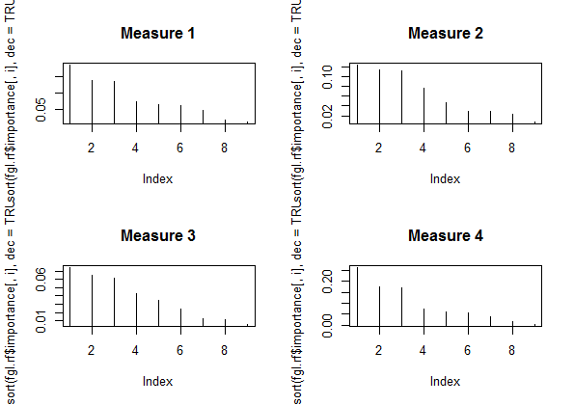
Variable Importance of the Forensic Glass Data Set
par(mfrow = c(2, 2))
for (i in 1:4) plot(sort(fgl.rf$importance[,i], dec = TRUE), type = "h", main = paste("Measure", i))

Slide 18
Example: Primary Biliary Cirrhosis (PBC) Data
Data was obtained from a Mayo Clinic randomized trial in primary biliary cirrhosis (PBC) of the liver conducted between 1974 and 1984.
A total of 424 PBC patients, referred to Mayo Clinic during that ten year interval met eligibility criteria for the randomized placebo controlled trial of the drug D-penicillamine (DPCA).
The data and partial likelihood model is described in Fleming and Harrington (1991)
The pbc data set included in the randomForestSRC package contains 418 observations, with 312 patients participating in the randomized trial.
> data(pbc, package = "randomForestSRC")

Slide 19
The PBC Data
factor | label | type
status | event indicator (F = censor T = death) | logical
treatment | Treament (DPCA Placebo) | factor
age | age in years numeric sex Female | logical
ascites | Asictes logical
hepatom | Hepatomegaly | logical
spiders | Spiders | logical
edema | Edema | factor
bili | serum bilirubin (mg/dl) | numeric
chol | serum cholesterol (mg/dl) | integer
albumin | albumin (gm/dl) | numeric
copper | urine copper (ug/day) | integer
alk | alkaline phosphatase (U/liter) | numeric
sgot | SGOT (U/ml) | numeric
trig | triglicerides (mg/dl) | integer
platelet | platelets per cubic ml/1000 | integer
prothrombin | prothrombin time (sec) | numeric
stage | histologic stage factor years survival time (years) | numeric

Slide 20
Exploratory Data Analysis (EDA) (Tukey 1977)
Descriptive statistic metrics
Measures of central tendency
Measures of deviation
Data distribution
Continuous
Discrete
Graphical metrics
Histogram
Scatterplot
Box plot
edema |  | bili |  | chol
Min. : | 0 | Min. : | 0.3 | Min. : | 120
1st Qu.: | 0 | 1st Qu.: | 0.8 | 1st Qu.: | 249.5
Median : | 0 | Median : | 1.4 | Median : | 309.5
Mean : | 0.1005 | Mean : | 3.221 | Mean : | 369.5
3rd Qu.: | 0 | 3rd Qu.: | 3.4 | 3rd Qu.: | 400
Max. : | 1 | Max. : | 28 | Max. : | 1775
 |  |  |  | NA's : | 134

Slide 21
Transform Data for Analysis and/or Modeling
Days to Years
> pbc1<-pbc
> pbc1$Years <- pbc1$days/365
> pbc1$Age <- pbc1$age/365
> pbc$Status <-
ifelse(pbc$status > 0,"T","F")
> pbc$status
pbc$status
[1] "T" "F" "T" "T" "F" "T" "F" "T" "T" "T" "T" "T"
[13] "F" "T" "T" "F" "T" "T" "F" "T" "F" "T" "T" "T"
[25] "F" "T" "T" "T" "F" "T" "T" "F" "T" "F" "T" "F"
[37] "T" "T" "T" "F" "T" "F" "F" "T" "F" "T" "F" "F"
[49] "T" "T" "T" "T" "T" "T" "T" "T" "T" "F" "T" "F"
[61] "F" "T" "T" "T" "F" "T" "T" "F" "T" "F" "F" "F"
[73] "F" "T" "T" "T" "T" "T" "F" "T" "T" "T" "F" "F"
[85] "T" "T" "T" "F" "T" "T" "T" "T" "F" "T" "T" "F"
[97] "T" "F" "F" "T" "F" "F" "T" "T" "F" "T" "F" "T"
[109] "F" "T" "F" "T" "T" "T" "F" "F" "T" "T" "T" "F"
[121] "T" "F" "T" "F" "F" "T" "F" "T" "F" "T" "T" "F"
[133] "T" "F" "F" "F" "F" "T" "F" "F" "F" "T" "T" "T"
[145] "F" "F" "F" "T" "T" "F" "F" "T" "F" "T" "F" "T"
0,1 to T,F
True = Death
False = No Death

Slide 22
Drop Replaced Data
status treatment age sex ascites hepatom spiders
1 T 1 21464 1 1 1 1
2 T 1 20617 1 0 1 1
3 T 1 25594 0 0 0 0
4 T 1 19994 1 0 1 1
edema bili chol albumin copper alk sgot trig
1 1.0 14.5 261 2.60 156 1718.0 137.95 172
2 0.0 1.1 302 4.14 54 7394.8 113.52 88
3 0.5 1.4 176 3.48 210 516.0 96.10 55
4 0.5 1.8 244 2.54 64 6121.8 60.63 92
platelet prothrombin stage Status Years
1 190 12.2 4 T 1.095890
2 221 10.6 3 F 12.328767
3 151 12.0 4 T 2.772603
4 183 10.3 4 T 5.273973
> pbc2<-pbc1[,2:21]
> head(pbc2)

Slide 23
Reshape: Melt the Data
dtb1<- melt(pbc2, id.vars=c("Age","Years","status"))
dtb2<- melt(pbc2, id.vars=c("bili","Years","status"))
dtb3<- melt(pbc2, id.vars=c("albumin","Years","status"))
.
.
.
dtb10<- melt(pbc2, id.vars=c("platelet","Years","status"))
> dtb1
Age Years status variable value
1 58.80548 1.0958904 T treatment 1.00
2 56.48493 12.3287671 F treatment 1.00
3 70.12055 2.7726027 T treatment 1.00
4 54.77808 5.2739726 T treatment 1.00
5 38.13151 4.1205479 F treatment 2.00
6 66.30411 6.8575342 T treatment 2.00
7 55.57260 5.0191781 F treatment 2.00
8 53.09315 6.7561644 T treatment 2.00
9 42.53699 6.5753425 T treatment 1.00
10 70.60822 0.1397260 T treatment 2.00

Slide 24
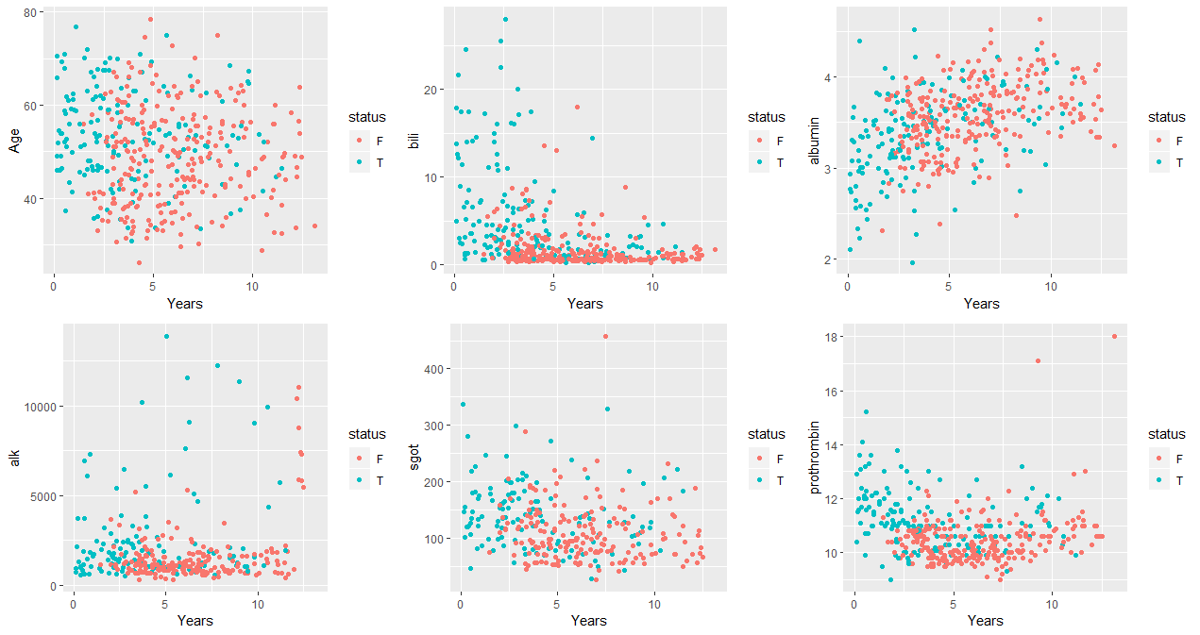
Factors versus Years by Status
gg1<-ggplot(data=dtb1, aes(x=Years, y=Age)) +
geom_point(aes(x=Years, color=status)) +
scale_fill_brewer(type="seq", palette = "Set1")

Slide 25
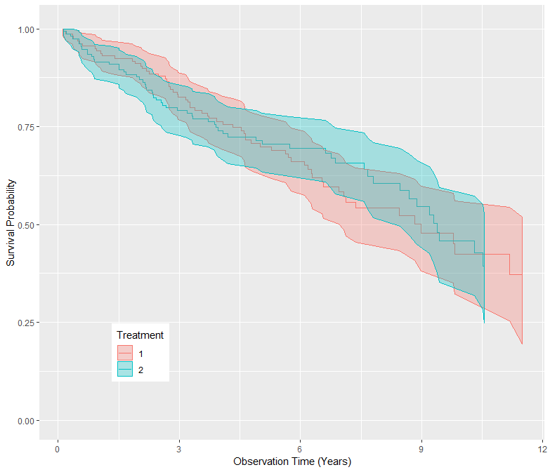
Build Trial & Test Sets for Survival Analysis
# Include only the randomized patients.
pbc.trial <- pbc2[-which(is.na(pbc2$treatment)),]
# Create a test set from the remaining patients
pbc.test <- pbc2[which(is.na(pbc2$treatment)),]
# Create the gg_survival object
gg_dta <- gg_survival(interval = "Years",
censor = "status",
by = "treatment",
data = pbc.trial,
conf.int = .95)
Survival Probability Function

Slide 26
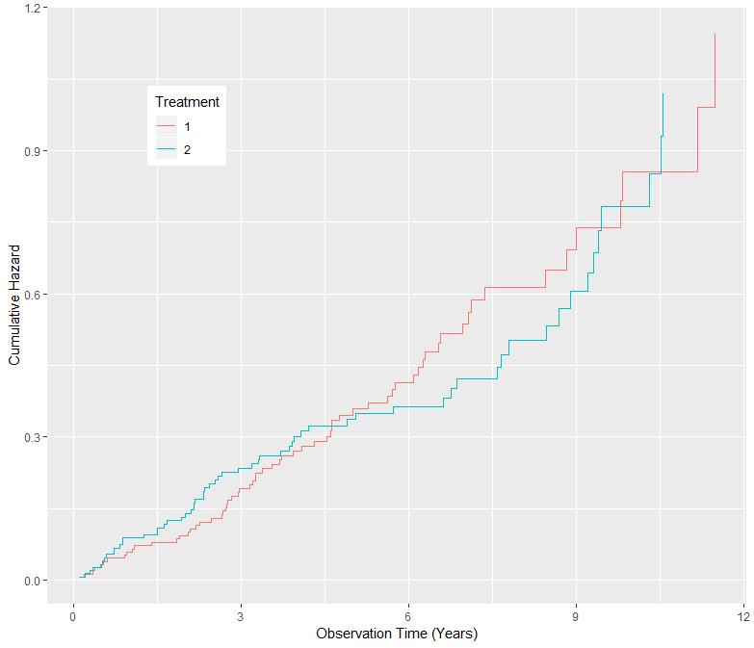
Cumulative Hazard Function
Cumulative Hazard Function
> plot(gg_dta, type="cum_haz") +
labs(y = "Cumulative Hazard",
x = "Observation Time (Years)",
color = "Treatment",
fill = "Treatment") +
theme(legend.position = c(.2,.8))

Slide 27
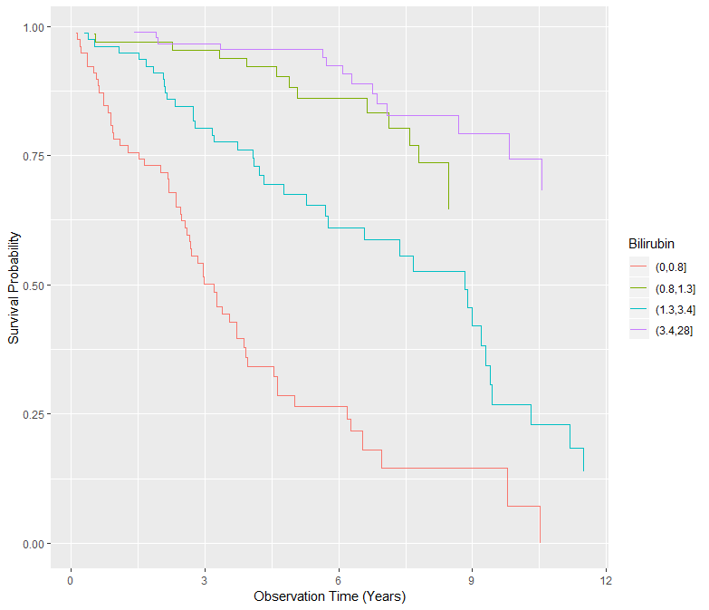
Plot the Survival Object Directly
> # Duplicate the trial data
> pbc.bili <- pbc.trial
> # Group by bilirubin values
> pbc.bili$bili_grp <- cut(pbc.trial$bili,
breaks = c(0, .8, 1.3, 3.4,
max(pbc.trial$bili)))
# plot the gg_survival object directly
> plot(gg_survival(interval = "Years",
censor = "status",
by = "bili_grp", data = pbc.bili),
error = "none") +
labs(y = "Survival Probability",
x = "Observation Time (Years)",
color = "Bilirubin")

Slide 28
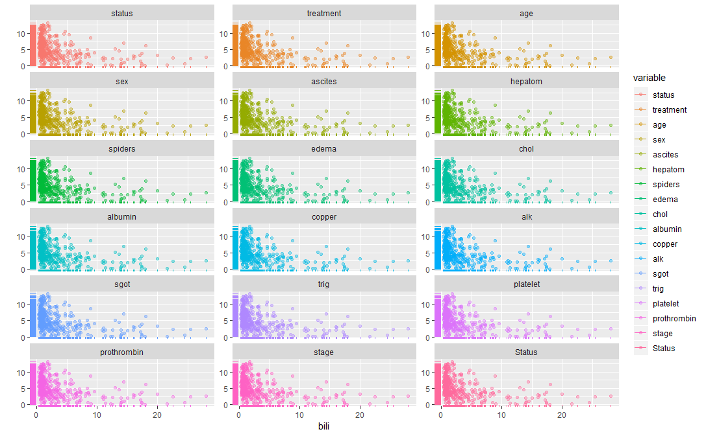
Changing the Color Palette
> ggplot(dta, aes(x=bili,
y=Years,
color=variable)) +
geom_point(alpha=.4) +
geom_rug(data=dta) +
labs(y="", x="bili") +
scale_fill_gradientn(colors =
colorspace::rainbow_hcl(17)) +
facet_wrap(~variable,
scales="free_y", ncol=3)
Increase number of colors from 12 to > 40

Slide 29
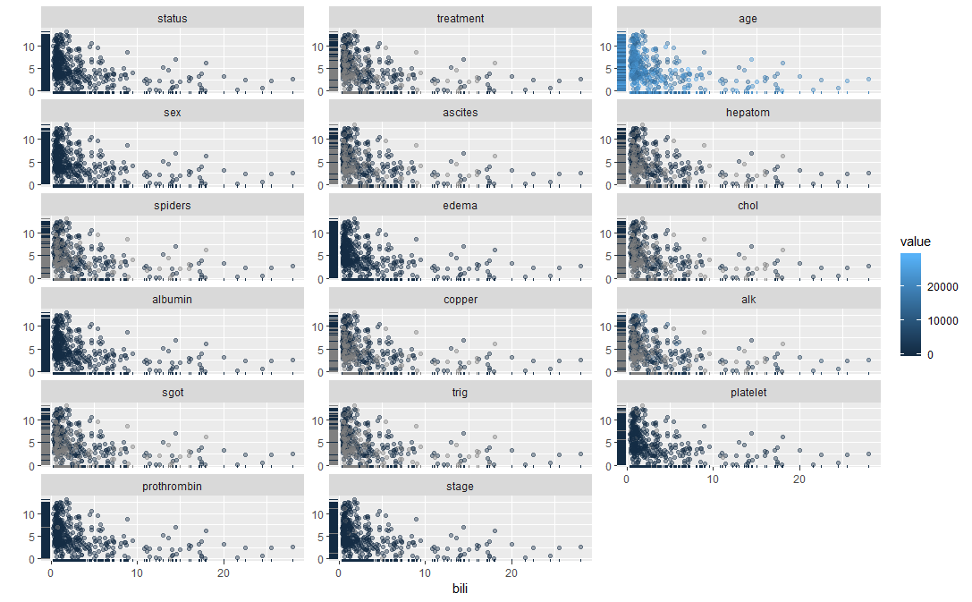
Factors versus Bilirubin by Value
> ggplot(dta, aes(x=bili,
y=Years,
color=value)) +
geom_point(alpha=.4) +
geom_rug(data=dta) +
labs(y="", x="bili") +
scale_fill_brewer (
type = "seq",
palette = "Set2") +
facet_wrap(~variable,
scales="free_y", ncol=3)

Slide 30
Grow a Random Forest
> # Grow and store the random
> # survival forest
> rfsrc_pbc <- rfsrc(Surv(
Years, status) ~ .,
data = pbc.trial)
> rfsrc_pbc
Sample size: 276
Number of deaths: 111
Number of trees: 1000
Forest terminal node size: 3
Average no. of terminal nodes: 67.267
No. of variables tried at each split: 5
Total no. of variables: 17
Analysis: RSF
Family: surv
Splitting rule: logrank
Error rate: 17.01%

Slide 31
Imputed Data versus Data with Missing Values
> rfsrc_pbc
Sample size: 276
Number of deaths: 111
Number of trees: 1000
Forest terminal node size: 3
Average no. of terminal nodes: 67.289
No. of variables tried at each split: 5
Total no. of variables: 17
Analysis: RSF
Family: surv
Splitting rule: logrank
Error rate: 17.4%
> rfsrc_pbc2
Sample size: 312
Number of deaths: 125
Was data imputed: yes
Number of trees: 1000
Forest terminal node size: 3
Average no. of terminal nodes: 74.167
No. of variables tried at each split: 5
Total no. of variables: 17
Analysis: RSF
Family: surv
Splitting rule: logrank *random*
Number of random split points: 10
Error rate: 16.2%

Slide 32
Predict survival for 106 patients not in trial
> rfsrc_pbc_test <-
predict(rfsrc_pbc,
newdata = pbc.test,
na.action = "na.impute")
# Print prediction summary
> rfsrc_pbc_test
Sample size of test (predict) data: 106
Number of deaths in test data: 36
Was test data imputed: yes
Number of grow trees: 1000
Average no. of grow terminal nodes: 67.267
Total no. of grow variables: 17
Analysis: RSF
Family: surv
Test set error rate: 19.9%

Slide 33
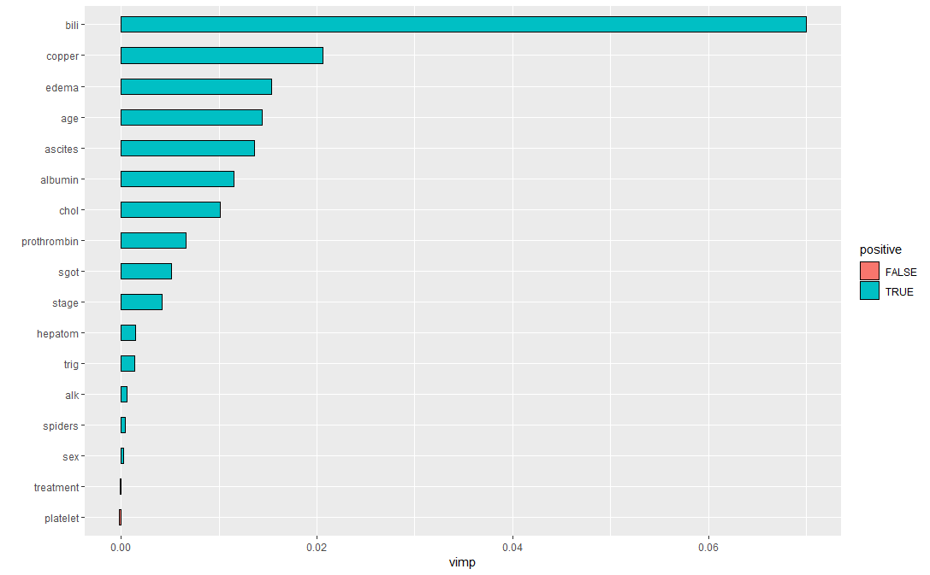
Variable Importance (VIMP)
> gg_variable(rfsrc_pbc)
> gg_dta<-gg_vimp(rfsrc_pbc)
> gg_dta
> plot(gg_dta)
vars set vimp positive
1 bili VIMP 0.0700494361 TRUE
2 copper VIMP 0.0205751222 TRUE
3 edema VIMP 0.0153220538 TRUE
4 age VIMP 0.0144179952 TRUE
5 ascites VIMP 0.0136341071 TRUE
6 albumin VIMP 0.0114650193 TRUE
7 chol VIMP 0.0101062447 TRUE
8 prothrombin VIMP 0.0065723315 TRUE
9 sgot VIMP 0.0051393856 TRUE
10 stage VIMP 0.0041473418 TRUE

Slide 34
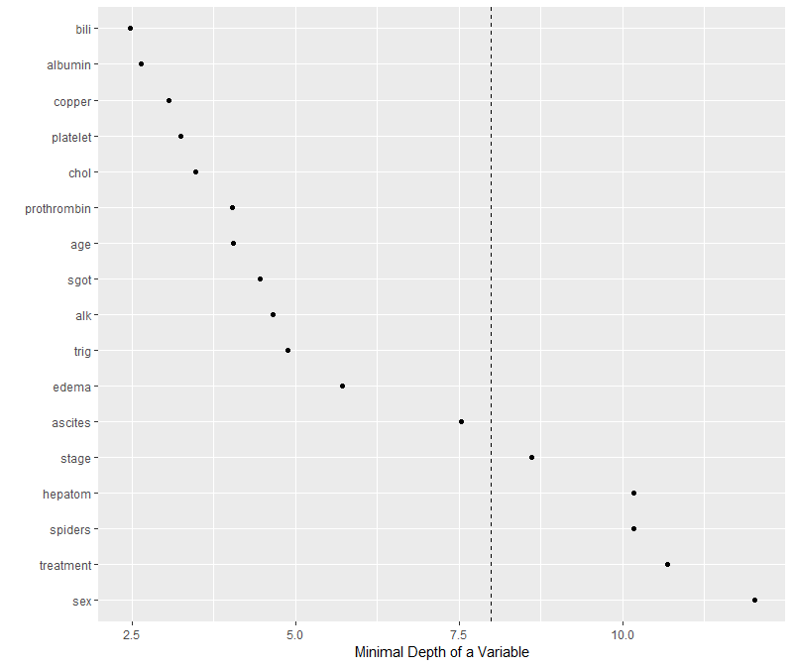
Both Minimal Depth and VIMP Measures
> # Return an object with both
> # minimal depth and vimp measures
> varsel_pbc <- var.select(rfsrc_pbc1)
> ggMindepth <- gg_minimal_depth(
varsel_pbc, lbls = Years)
> print(ggMindepth)
> plot(ggMindepth)

Slide 35
Both Minimal Depth and VIMP Measures
> print(ggMindepth)
Top variables
Rank | Factor | Depth | VIMP | Rank
1 | bili | 2.46 | 0.07005 | 1
2 | albumin | 2.64 | 0.01147 | 6
3 | copper | 3.06 | 0.02057 | 2
4 | platelet | 3.25 | NA | NA
5 | chol | 3.47 | 0.0101 | 7
6 | prothrombin | 4.03 | 0.00657 | 8
7 | age | 4.04 | 0.01441 | 4
8 | sgot | 4.46 | 0.00513 | 9
9 | alk | 4.66 | NA | NA
10 | trig | 4.88 | NA | NA
11 | edema | 5.71 | 0.01532 | 3
12 | ascites | 7.53 | 0.01363 | 5

Slide 36
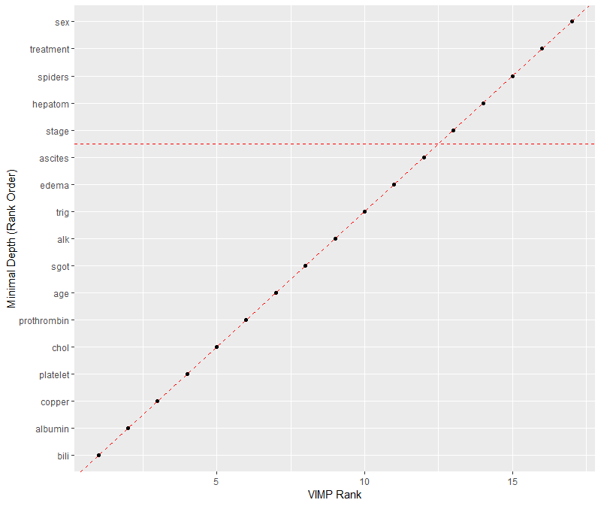
Both Minimal Depth and VIMP Measures
> plot(gg_minimal_vimp(ggMindepth))

Slide 37
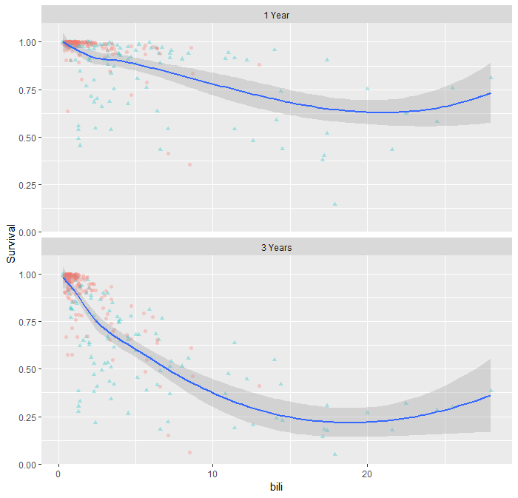
Survival versus Bilirubin Levels for 1 & 3 Years
> plot(ggrf, xvar = "bili",
se = .95, alpha = .3) +
labs(y = "Survival", x = "bili") +
theme(legend.position = "none")

Slide 38
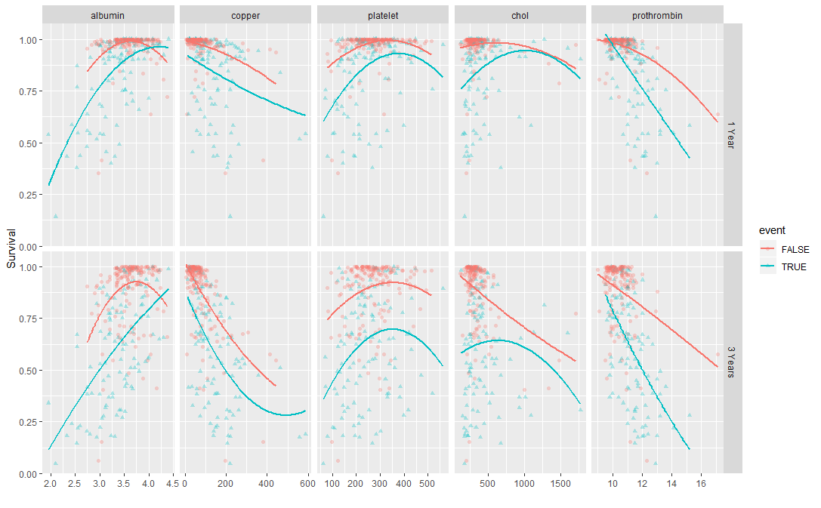
Bilirubin variable dependence at 1 and 3 years
> # Pull the categorical variables
> xvar.cat <- c("edema", "stage")
> xvar <- xvar[-which(
xvar %in% xvar.cat)]
> # plot the next 5 continuous
> # variable dependence plots.
> plot(ggrf, xvar = xvar[2:6],
panel = TRUE,
se = FALSE, alpha = .3,
method = "glm", formula =
y~poly(x,2)) +
labs(y = "Survival")

Slide 39
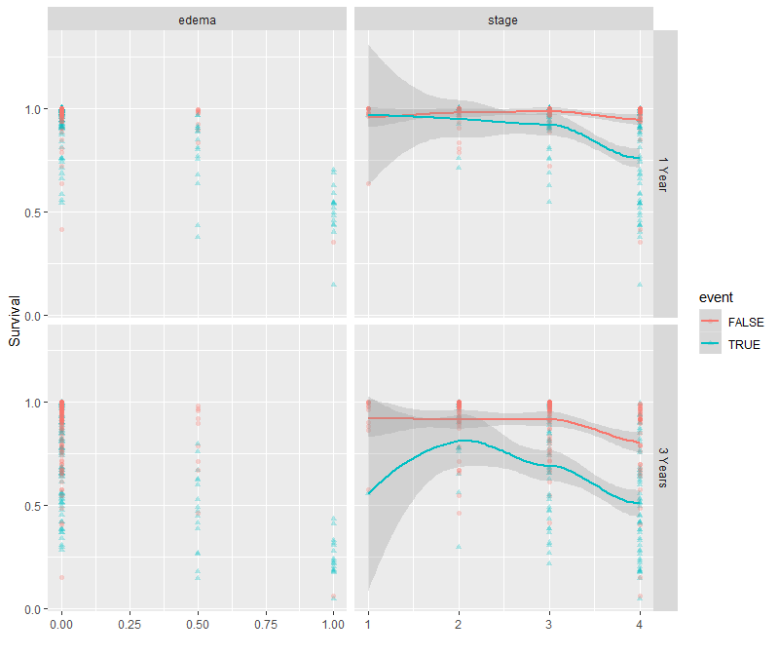
Variable Dependence Plots
> plot(ggrf, xvar = xvar.cat,
panel = TRUE, notch = TRUE,
alpha = .3) +
labs(y = "Survival") +
scale_fill_gradientn(colours =
colorspace::rainbow_hcl(17))

Slide 40
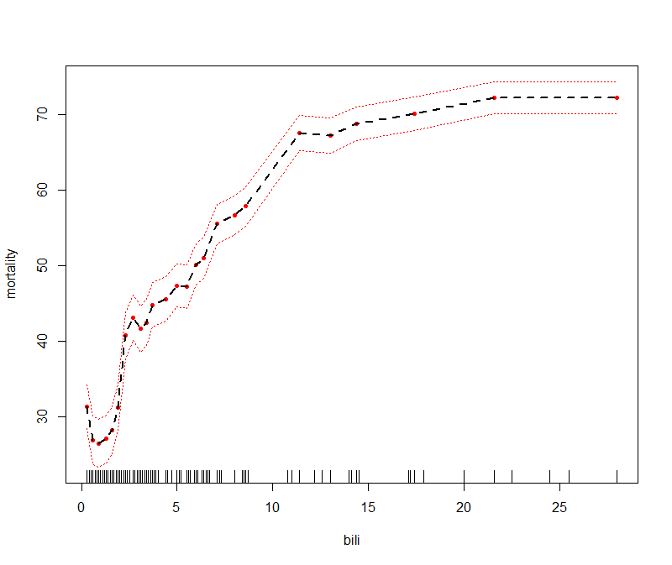
Factor Partial Plots versus Mortality
> partial_age <- plot.variable(rfsrc_pbc,
xvar.names = "age", partial=TRUE)
> partial_alk <- plot.variable(rfsrc_pbc,
xvar.names = "alk", partial=TRUE)
> partial_alb <- plot.variable(rfsrc_pbc,
xvar.names = "albumin",partial=TRUE)
.
.
.
> partial_edema<- plot.variable(rfsrc_pbc,
xvar.names = "edema", partial=TRUE)

Slide 41
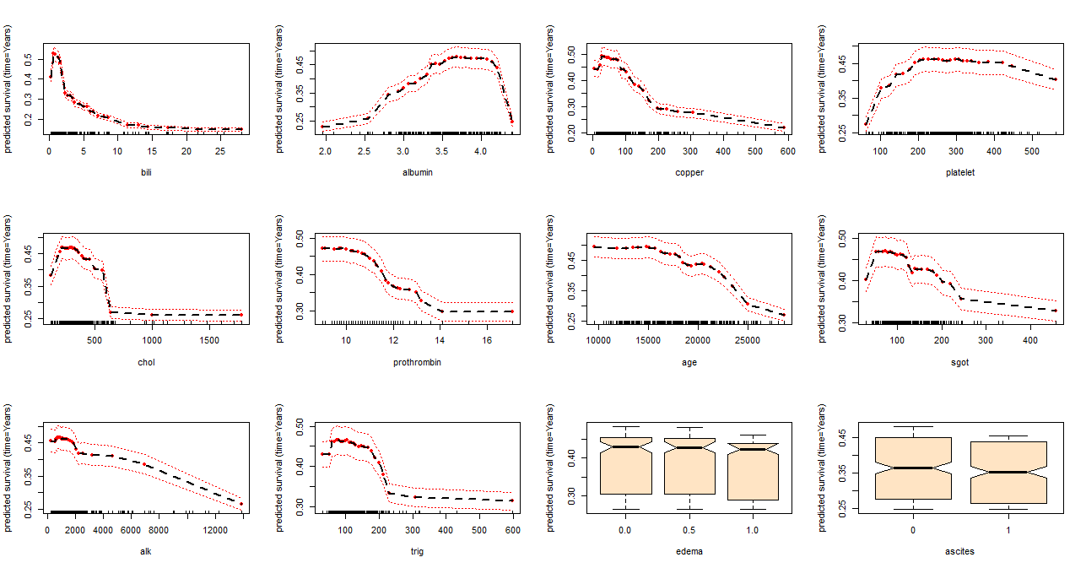
Factor Partial Plots versus Predicted Survival

Slide 42
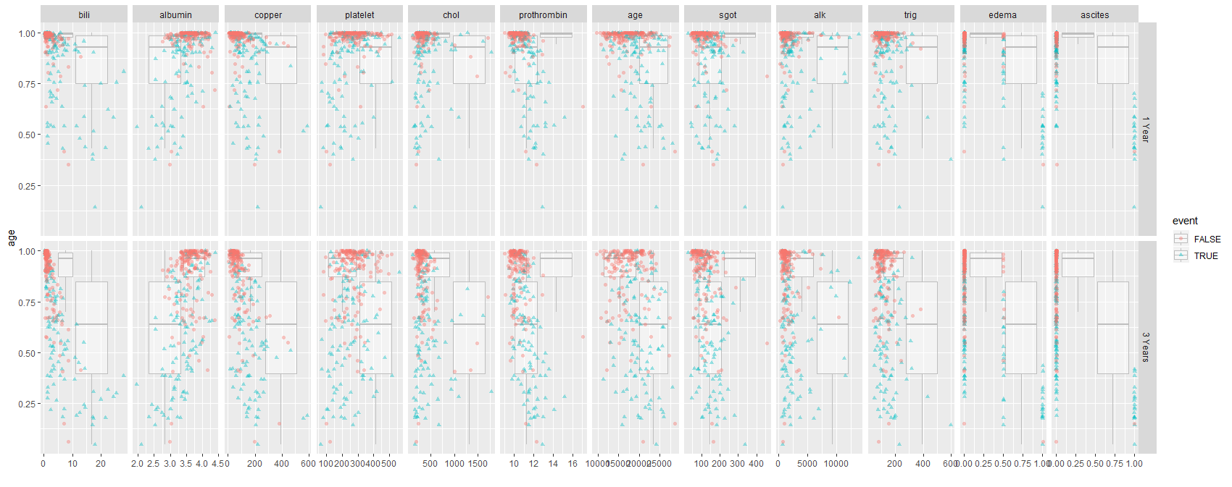
Factors Boxplots with Scatterplots by Events

Slide 43
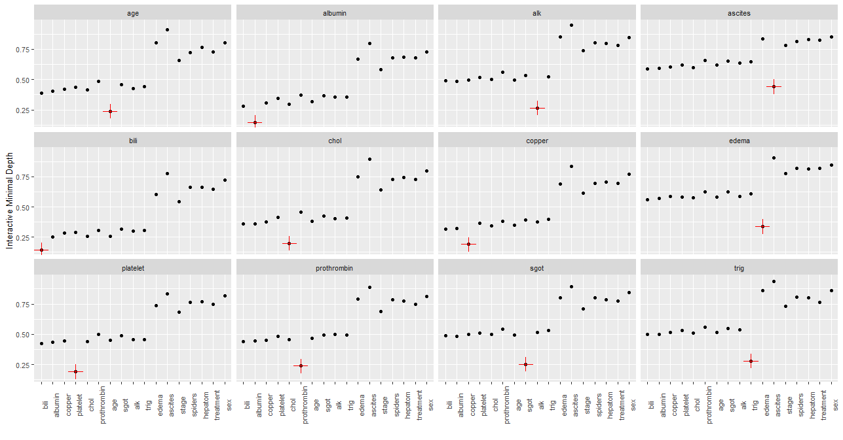
Minimal Depth Variable Interaction Panel with Factors

Slide 44
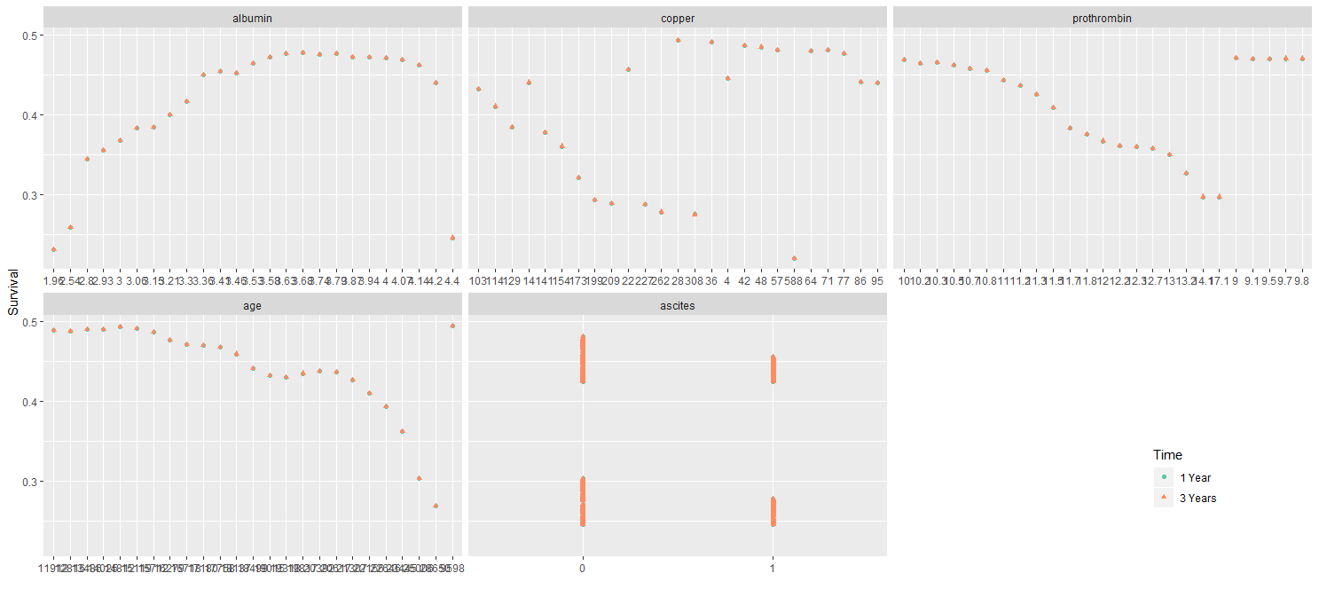
Variable Dependencies for 1 & 2 Years

Slide 45
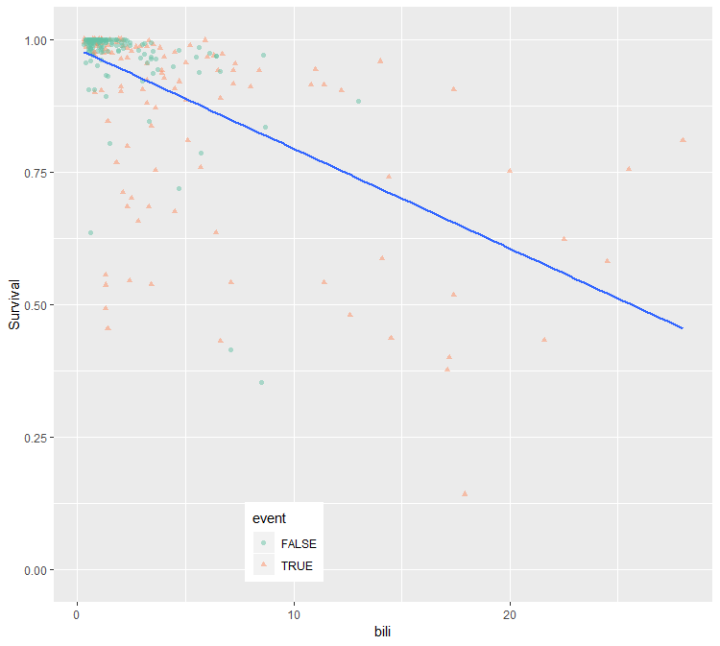
Variable Dependence Plot with GLM Fit
> ggvar <- gg_variable(
rfsrc_pbc, time = 1)
ggvar$stage <- paste("stage = ",
ggvar$stage, sep = "")
var_dep <- plot(ggvar,
xvar = "bili", method = "glm",
alpha = .5, se = FALSE) +
labs(y = "Survival", x = "bili") +
theme(legend.position = c(.35, .1)) +
scale_color_brewer(palette = "Set2") +
scale_shape(solid=TRUE) +
coord_cartesian(y = c(-.01,1.01))
var_dep

Slide 46
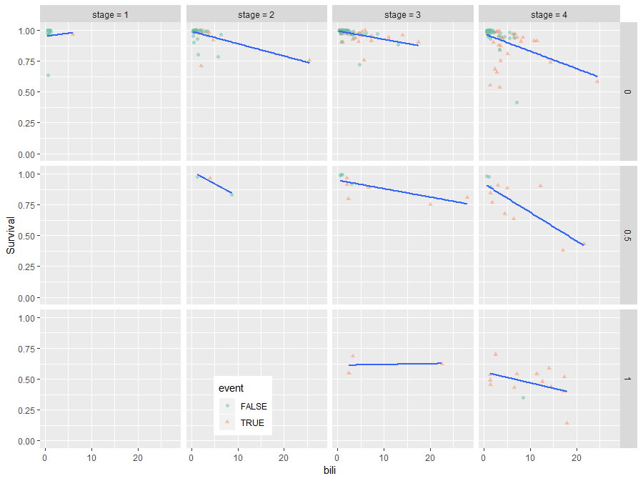
Bilirubin Dependences by State
> var_dep + facet_grid(edema~stage)
> # Find intervals with similar
> # number of observations.
> copper_cts <-quantile_pts(
ggvar$copper, groups = 6,
intervals = TRUE)

Slide 47
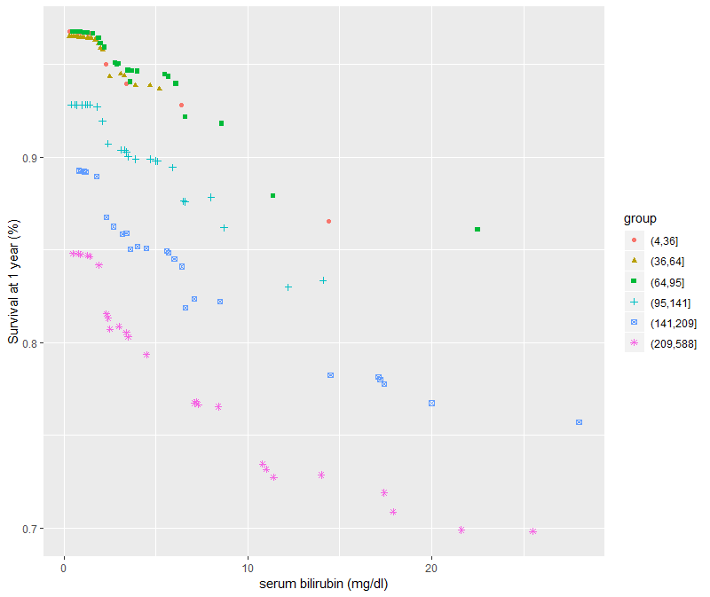
Partial (risk adjusted) Variable Dependence Coplot
> plot(partial_coplot_pbc) +
labs(x = "bili",
y = "Survival at 1 year (%)“)

Slide 48
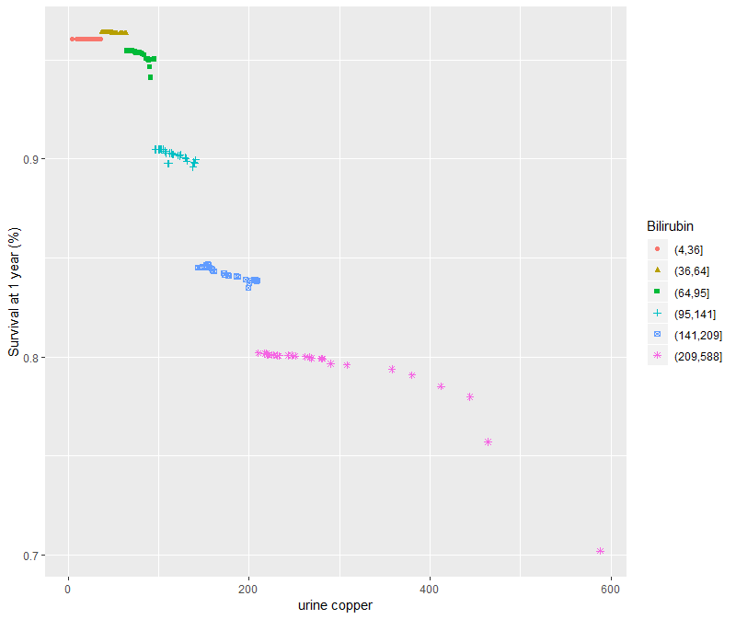
Partial (risk adjusted) Variable Dependence Coplot
> data(partial_coplot_pbc,
package = "ggRandomForests")
> plot(partial_coplot_pbc) +
labs(x = "urine copper",
y = "Survival at 1 year (%)",
color = "Bilirubin",
shape = "Bilirubin") +
scale_color_brewer(
palette = "Set2") +
coord_cartesian(y = c(49,101))

Slide 49
www.humalytica.com
http://www.amazon.com/Jeffrey-Strickland/e/B00IQ69QZK/
http://www.lulu.com/spotlight/strickland_jeffrey

